Slide 1
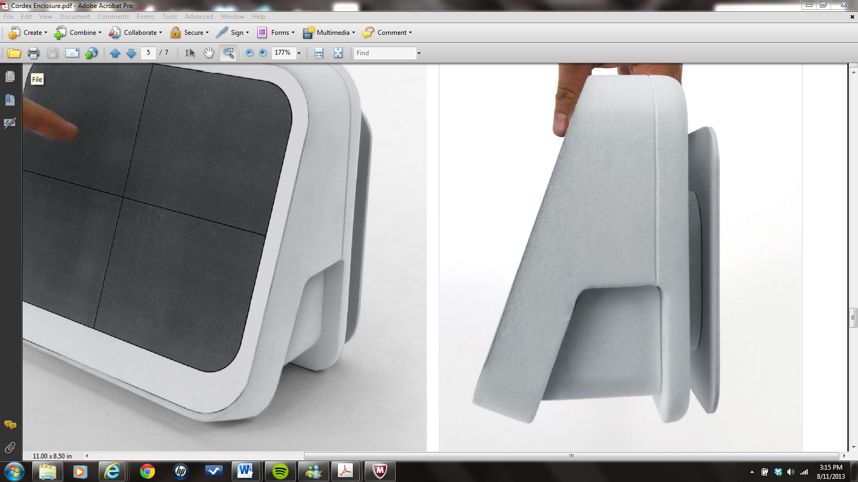
Cordex Enclosure

Slide 2
USB & Power
Power
4-port
0.7”
1.4”

Slide 3
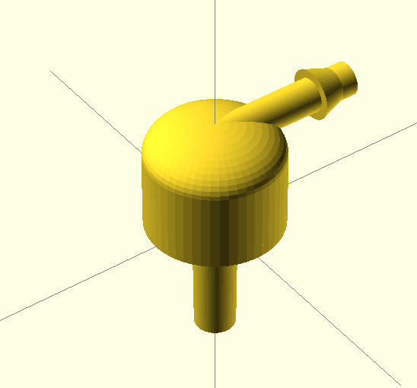
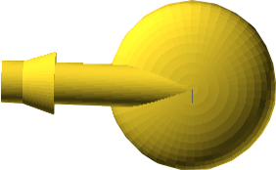
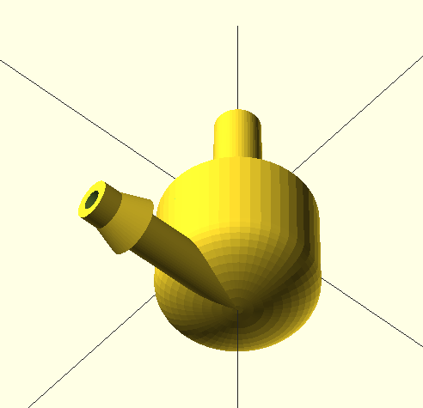
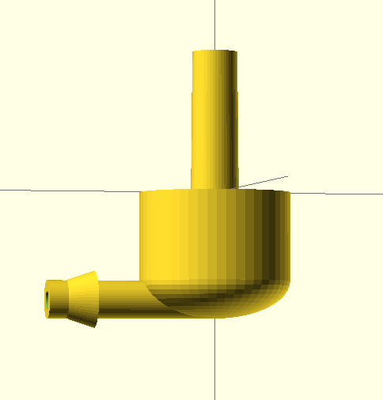
External Cuff Port

Slide 4
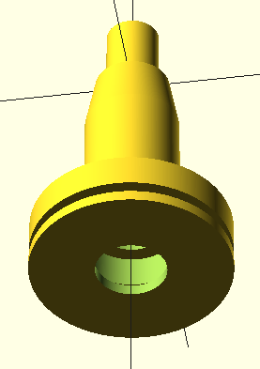
Internal Cuff Port
Manifold connection
Enclosure holds part by flange
Enclosure cutaway
O-Ring (not shown)

